Slide 1
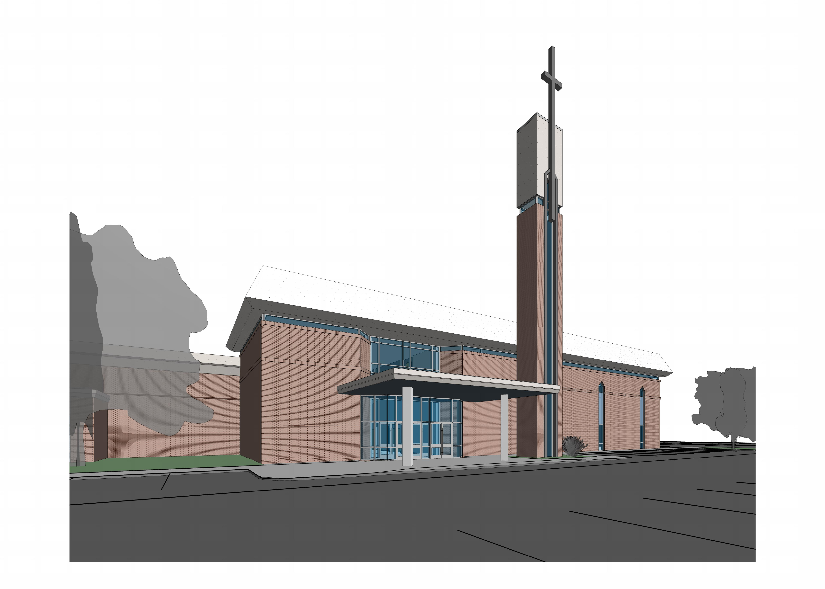
West Side
“Bring the whole tithe into the storehouse, that there will be food in my house. Test me in this”, says the LORD Almighty, “and see if I will not throw open the floodgates of heaven and pour out so much blessing that there will not be room enough to store it.” Malachi 3:10
Notes:
- Introduce Tom Wills and Dwight Fugua.

Slide 2
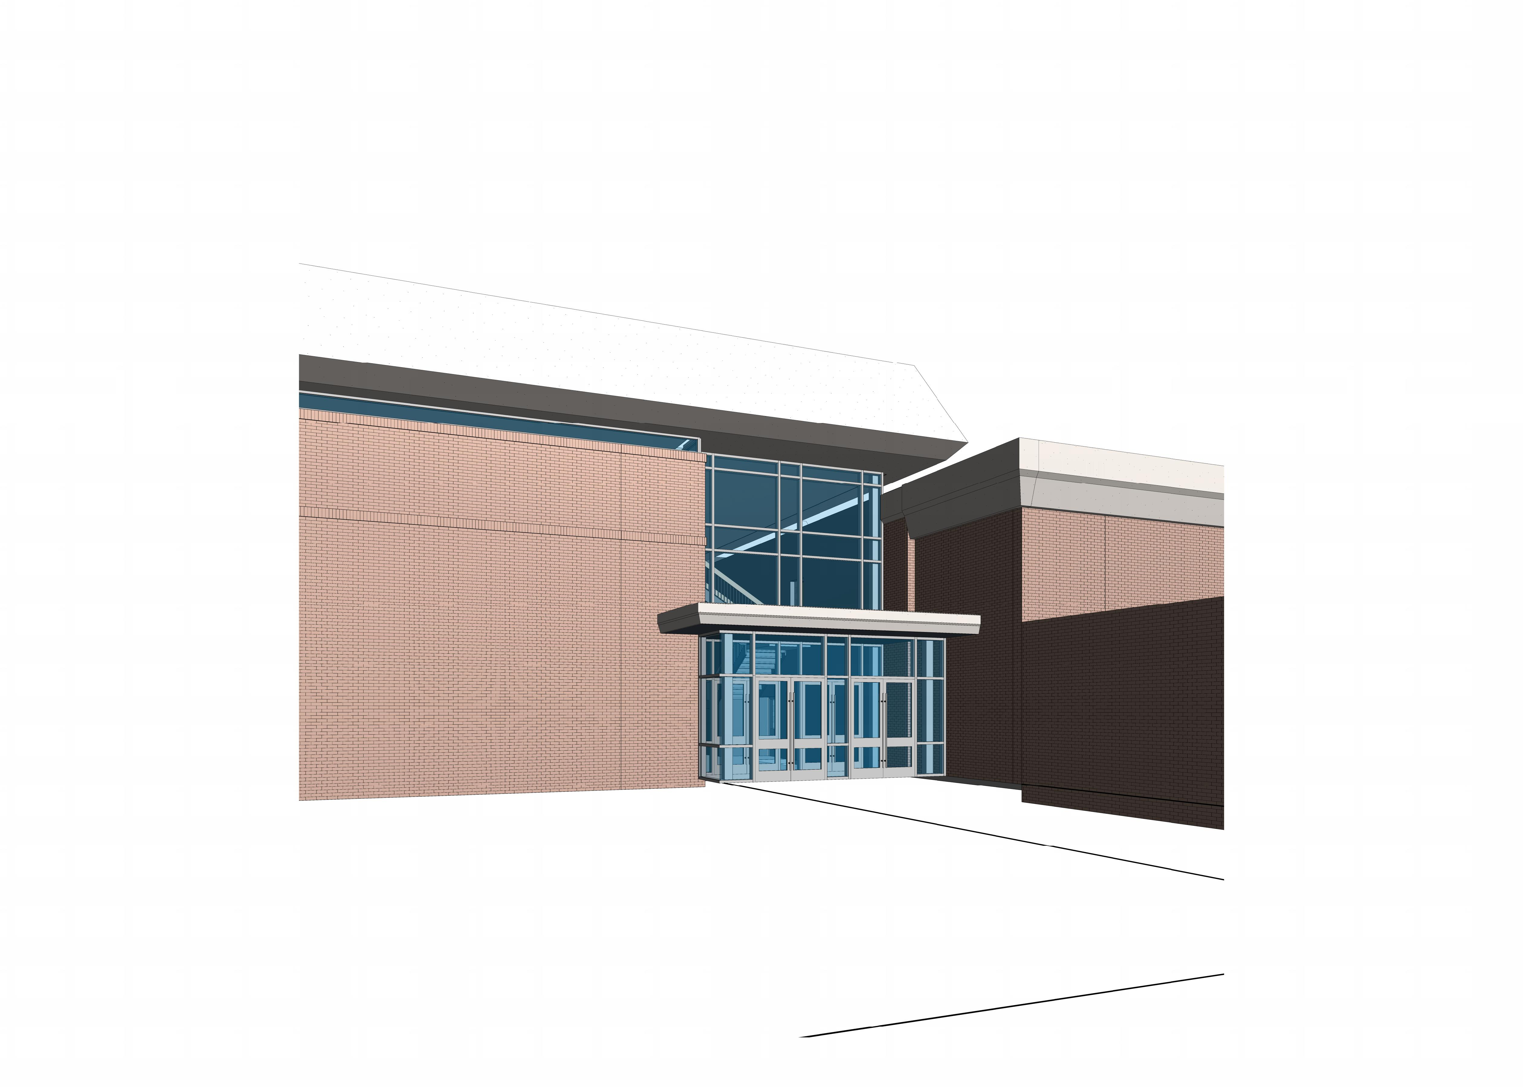
East Side

Slide 3
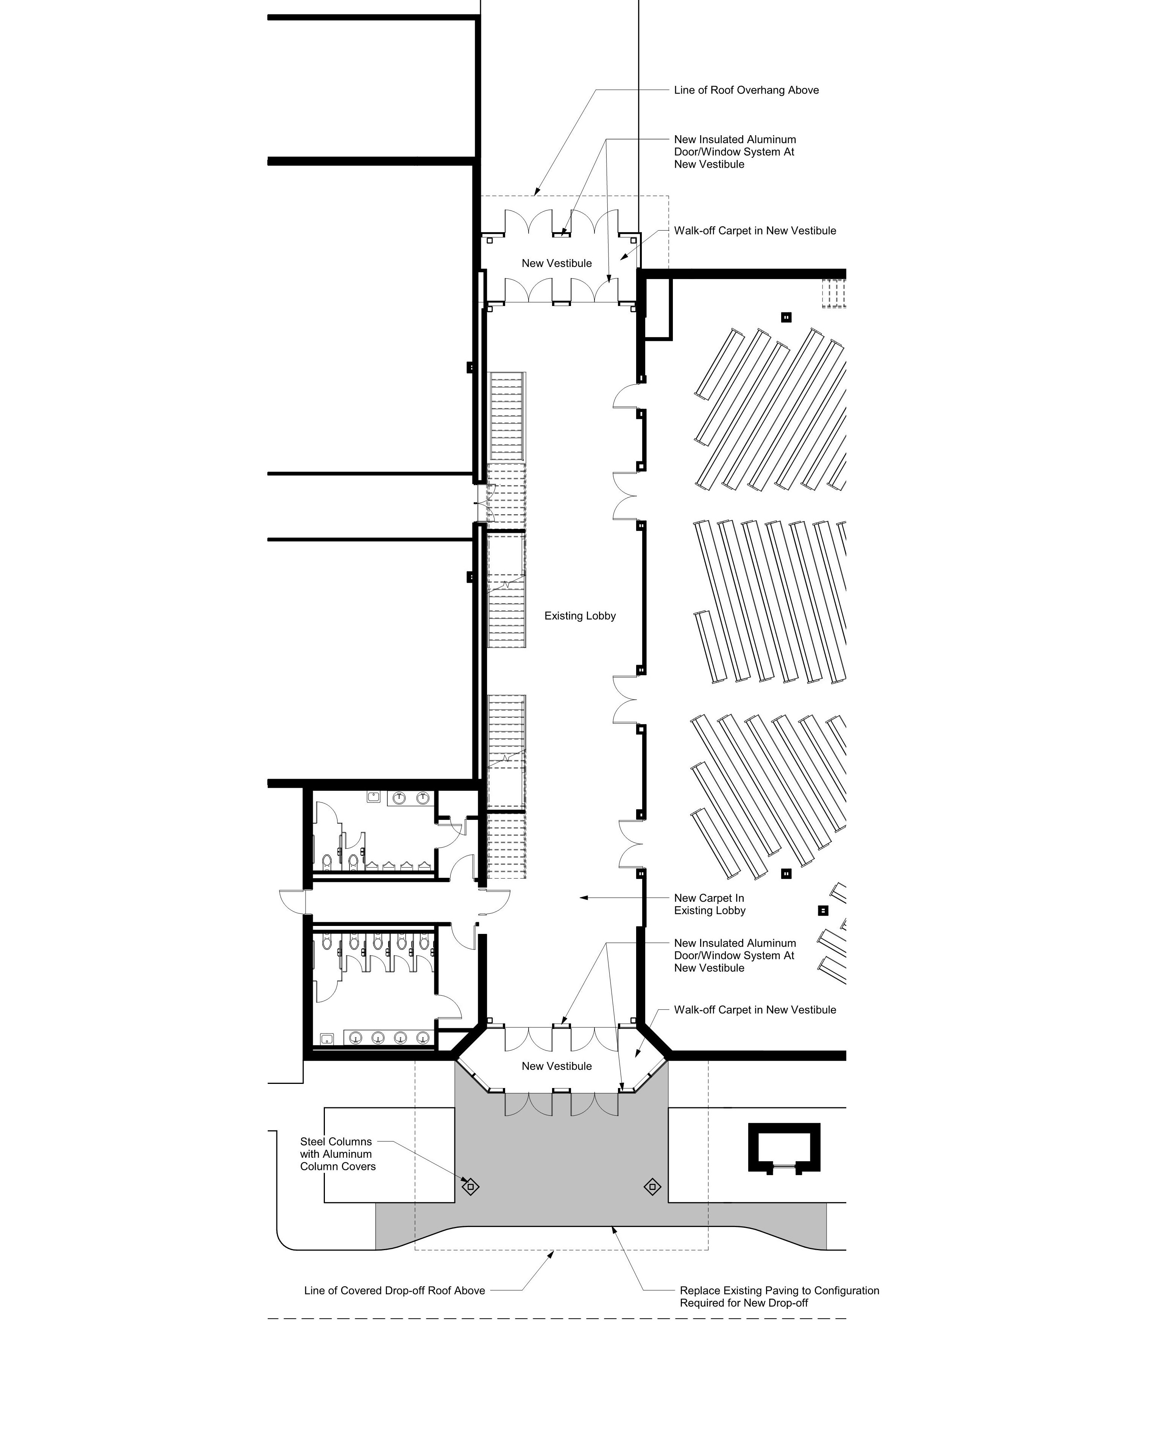

Slide 4
Session outline
Present and respond to emailed questions
Open the floor to new questions
Commentary – will be 3 minute time limit
It’s Time!
Notes:
- If tonight goes anything like the emails, some people will migrate from a question to “commentary”. We will support this, but will be putting a 3 minute time limit for each person.

Slide 5
What did we receive?
Questions and Commentary
Authors will remain anonymous
Good News – everyone loved the design!
I’m For It!

Slide 6
Question 1
“I would like to understand why there are outer doors and inner doors on both sides. I know it is currently like that, but do not understand the need for it in the new design.”
ANSWER: It is related to both safety and heating/air conditioning.
It’s The Right Thing To Do!
Notes:
- Hot/cold air stay between the doors rather than “drafting” into the foyer area.
- 2 doors provide an additional barrier for the building.

Slide 7
Question 2
“If not already, please clarify vote threshold required to go forward with proposal of this cost related to the current budget, per the by-laws.:
ANSWER:
A major building project is one that is greater than twenty-five percent (25%) of the last year’s budget.
The approval of a major building project requires a percentage of eighty-five percent (85%) of the church members voting.
Improve God’s House!
Notes:
- 2017 budget was $1,310,000 – 25% of that is a $315,000 threshold for minor or major project.

Slide 8
Question 3
“Did the committee obtain an update on the population in the HEB area related specifically to the Hurst area which showed the changes projected for the next 5-10-15-20 years including numbers of the increase/decrease in population, possible change in ethnic family income increase/decrease, and the possible consequences for SOBC.”
ANSWER: These topics were considered prior to the start of the BOC work. The vote last fall was for the BOC to drill down into the details for improving the access and visibility of the entrances.
Pray for Wisdom!
Notes:
- The previous committee’s work (Master Plan & 2017 Committee) would have considered these factors prior to presenting project options to the congregation in the Fall of 2017.

Slide 9
Question 4
“Is this debt for a ministry need or want? “If you build it, they will come” is a wrong philosophy. It comes from the 50’s era and debt is not to take shots in the dark, hoping for a positive outcome. What increase in attendance is anticipated by a study conducted which shows that increase?”
ANSWER: These topics were considered prior to the start of the BOC work. The vote last fall was for the BOC to drill down into the details for improving the access and visibility of the entrances
To Improve Access!
Notes:
The previous committee’s work (Master Plan & 2017 Committee) would have considered these factors prior to presenting project options to the congregation in the Fall of 2017.

Slide 10
Question 5
The recommendation of the B&F committee is to obtain a 4.25%, 20 year loan from the Baptist Church Loan Corporation. If my math is correct, after $100,000 down and rolling in the old note balance, the loan amount is $561,110. But to pay $3,475 X 20 years = $834,000. Then $834,000 - $561,110 = interest paid of $272,890. This seems like a large amount to pay in interest (since the total interest is about 48.5% of the loan amount).
Can a lower interest rate be obtained?
Could a 15 year loan lower the interest paid, without significantly raising the monthly loan payment?
Maybe the committee has already considered these other alternatives, just asking the questions since I am in favor of this project.
It’s Time To Improve Our Welcome!

Slide 11
Answer – question 5
Regarding obtaining a lower interest rate, Richard Adams, Executive Administrator, contacted several construction lending sources along with the BCLC with whom our current note is held. In summary, it was found that the going rates were either more or equal to the 4.25% offered by BCLC. That fact and considering SOBC’s longstanding relationship with BCLC, the B&F Committee chose BCLC.
The B&F Committee agrees that a shorter term note would be preferable. As you noted a 20-year note monthly payment would be $3,475. A 15-year note monthly payment would be $4,222. While either payment would exceed our current note payment, the Committee felt that the 15-year note payments would place undue financial constraints on the mission and ministry of the church.

Slide 12
Question 6
“Did the committee obtain from the budget and finance committee a detailed projection of budget income for the span of years above, especially related to the noted decrease in budget income the past several years which indicates a continued decline in said income and a possible time when projected income equals required spending which would necessitate radical adjustments and in such event a loan takes priority.”
Think Future SOBC!

Slide 13
Answer – question 6
Beyond having an overall familiarity with the historical giving pattern of the church, the B&F Committee made no formal attempt to project budget income. While it is true that for several years giving levels did drop, but in calendar 2017 and 2018 they have stabilized. In fact, calendar 2018 giving increasing from that of calendar 2017. In all those years, God has provided. In addition staff and operating committees have been very effectively controlling costs. In all that time, the Committee has not had to use cash reserves to subsidize operations. The Committee currently believes that, as has been experienced many times in SOBC’s history, that God WILL provide.

Slide 14
Question 7
“Can we pay the debt quickly? Twenty years is a long time and in a recent informal survey of giving by SOBC members showed that over 50% of the budget was being given by our senior group! Will debt and declining gifts be a good thing or create problems?”
ANSWER: While it is the B&F Committee’s goal to pay off debt as soon as possible and practicable, the Committee conservatively believes that may not happen. The Committee is well aware of the risk that giving may decline, but there is also the possibility of future growth.
To Invest Eternally

Slide 15
Question 8
“What will be the budgetary impact?
Will this 20 year debt cause us to be on the financial edge in current or later years?
Will we need to reduce ministry budgets to make payments?
As we have already been told adjustments have been required from ministry budgets to meet the declining income.”
ANSWER: The B&F Committee believes that at SOBC’s current giving level, along with the sound fiscal management currently being experienced that the project cost will not significantly impair the ministry programs of the church.
Enhancing God’s Kingdom!

Slide 16
Question 9
“ What are our other options? Should debt be our first resort. It may be easier, but that doesn’t mean it’s wiser. Should we perhaps look further at options. While debt is not necessarily a sin, it can be a burden, and we should be fully aware there are consequences of debt.”
ANSWER: Regarding options, the cheapest option, in the short run, would be to not do anything. The B&F Committee concurs with the Building Oversight Committee that would not be best. Another option would be for the church to raise all the funds up front and avoid debt. While that would be honorable and preferable, the B&F Committee believes that is not practical, maybe not even possible. That being said, the Committee sees no alternative to debt if the project is to be done.
To Improve Access: Physically Challenged

Slide 17
Absentee Voting
Absentee voting is only allowed on major building projects.
Absentee ballots will be available at the church office three (3) weeks prior to the church wide vote.
Absentee ballots will be numbered and only the numbered ballots will be deemed legal ballots.
The church member wishing to cast an absentee ballot must sign for the ballot to receive the numbered ballot.
All absentee ballots will be cast at the church prior to the church wide vote.
Homebound members may request a staff member bring a ballot to them and cast it at home with the staff member.
Absentee ballots may not be copied or duplicated.
Absentee ballots will be kept by the Church Secretary, in a sealed envelope, prior to the church wide vote.
Any ballots received after the church wide vote will be disregarded.
Notes:
- Ballots will be available 11/11. That is 3 weeks prior to the December 2nd vote.

Slide 18
TIME TO OPEN UP FOR QUESTIONS!
This Photo by Unknown Author is licensed under CC BY

Slide 19
Next Steps
VOTE!
Sunday, December 2nd
As a part of the Quarterly Business meeting held immediately after service.
Notes:
- New Decon vote, 2019 Budget, Committee Member and Project will all be voted on.

Slide 20
Please remember…….
The purpose of this project is mainly to support our current congregation’s ability to use our facility.
We have never defaulted on a loan in the 60 year history of this church.
It has been 35 years since we have made a significant improvement to our facility.
We as a Church Family need to pull together and support this project.
We can maintain the current monthly debt payment IF 250 giving units tithe an additional $3 per month.
It’s Time!

